Slide 1


UKIEPC 2020
Summary and solution outlines

Slide 2
Problem Solutions
Note: Many problems this year are shared with BAPC (https://2020.bapc.eu/)

Slide 3

Aquarium
Overview
We need to line some piranhas up for a group photo.
Putting a finger in the tank causes adjacent piranhas to start swimming toward the finger.
Find the number of seconds of finger exposure needed to put every fish in its specified place.
?? correct • solved at: ??:?? by
??
University of ??
Author: Freek Henstra

Slide 4
Aquarium - Solution
Techniques
Algorithm
Intervals
Greedy algorithms
Amortisation
Each fish needs to move by X_{i} places.
  The number of finger placements to the right must be X_{i} more than the number to the left.
Assume the number of placements to the left of the leftmost fish is -X₀.
  Then the next number must be 0, the next after that must be 0+X_{1,} then 0+X₁+X_{2,} etcetera.
  We need all values to be non-negative. Take the minimum of value and subtract it from everything.
Now we need to check if this number of placements is feasible
  The answer is guaranteed to be at most O(N*K²).
  So we can just go from left to right making all valid moves.

Slide 5
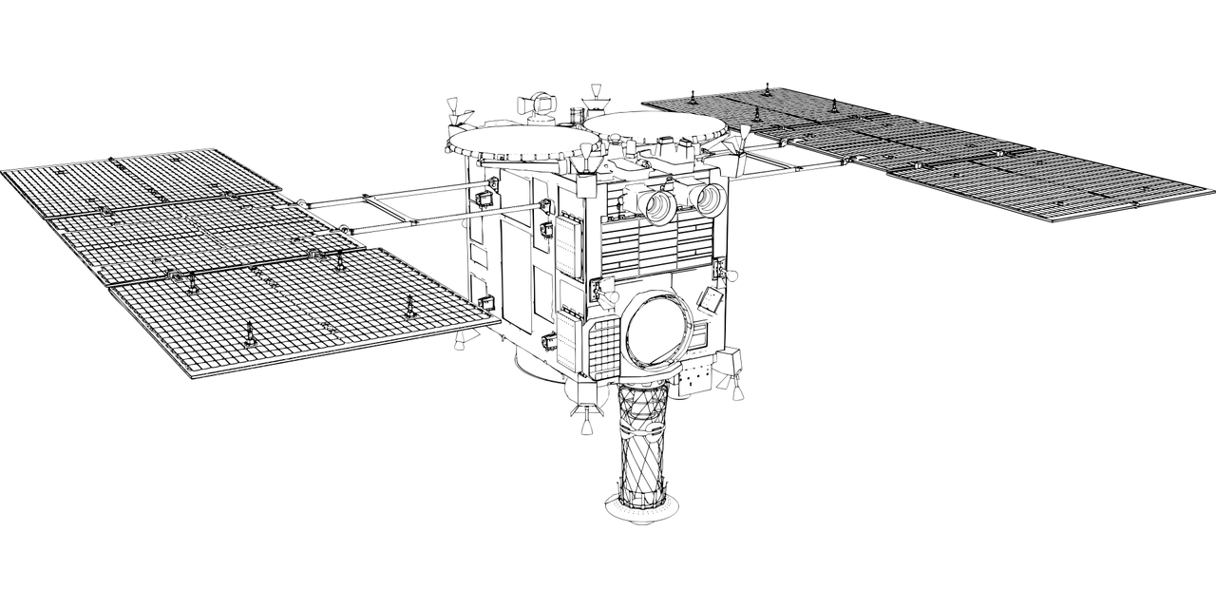
Bidirectional
Overview
Write a number < 10^18 as sum of ≤ 10 palindromic numbers.
?? correct • solved at: ??:?? by
??
??
Authors:
Ludo Pulles, Mike de Vries

Slide 6
Bidirectional Code - Solution
Techniques
Algorithm
Greedy
Recursion
Stubbornness
Idea: construct the biggest balanced number less than n greedily.
Example:
  n = 970 894 988 875 162 603
  p[1] = 970 894 987 789 498 079
  n − p[1] = 000 000 001 085 664 524
  p[2] = 000 000 001 085 555 801
  n − p[1] − p[2] = 000 000 000 000 108 723
Possible edge case: n = 10 ` : p = n − 1.
To get k ≤ 5: run a brute force to express n as sum of three balanced numbers when n ≤ 200 000.

Slide 7
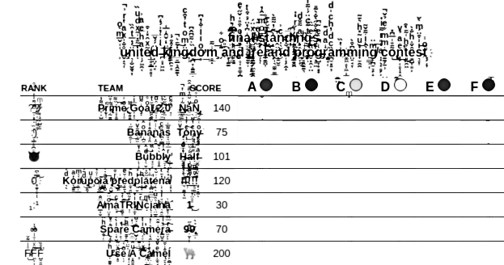
Corrupted Judge
Reconstruct a missing part of a contest scoreboard from other known parts.
?? correct • solved at: ??:?? by
??
??
Author: Boas Kluiving

Slide 8
Corrupted Judge- Solution
Techniques
Algorithm
Logic
Implementation
Zalgo
Starting at the last team fill in the corrupted column conservatively. The last team solved p[n]=1 problem.
  For i=n-1,...,1 p[i] = p[i+1] + (1 if t[i] <= t[i+1] else 0)
  If p[1] = p, then the scoreboard is non-ambiguous.
  Else p[1] = p gives another correct scoreboard (ambiguous)
Some special cases to deal with
  If no team has solved any problem, it is not ambiguous.

Slide 9
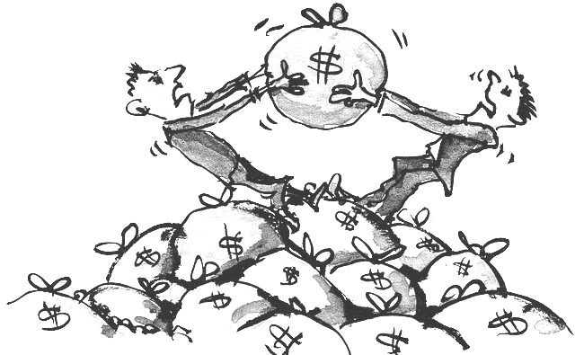
Divvying Up
Overview
Three professionals (one not pictured) are going to earn some money from individual events
Can they distribute the money equally?
?? correct • solved at: ??:?? by
??
??
Author: Robin Lee

Slide 10
Divvying Up - Solution
Techniques
Algorithm
Integers
We just need to know if the total is divisible by 3. So start by computing the total as the sum of the input array.
  In python, sum(map(int, input().split())) does the job.
Use your language’s modulus operator (usually “%”) to calculate the remainder from division.

Slide 11
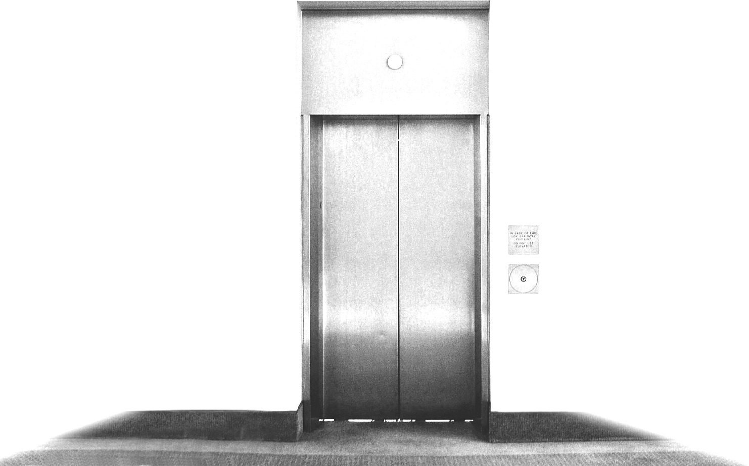
Elevator Pitch
Overview
Build the least number of elevators so that all buildings become accessible.
We need to count local maxima in the floor plan, but only once each.
?? correct • solved at: ??:?? by
??
??
Author:
Mees de Vries

Slide 12
Elevator Pitch - Solution
Techniques
Algorithm
Breadth-first search
Implicit graphs
Sort all of the locations in the grid by (descending) height
Go through all of the locations in this order:
  If the location is already visited, skip it.
  Otherwise, run a flood fill (BFS) from that location to all lower/equal locations, and mark them as visited.
Output the total number of flood fills needed

Slide 13
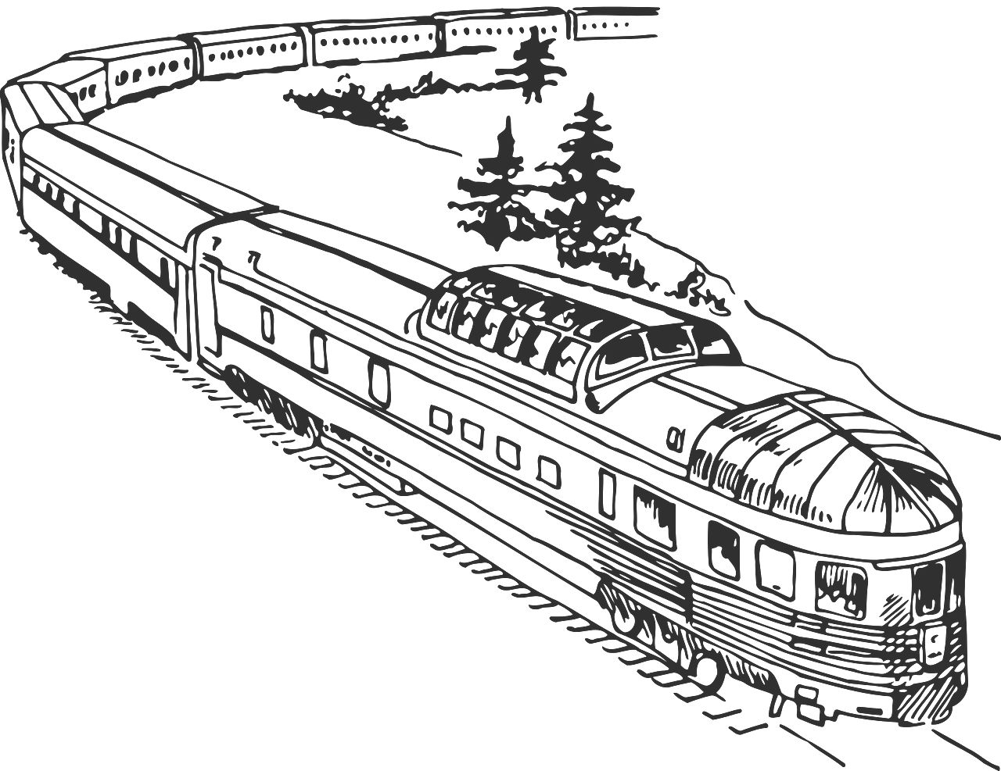
Family Fares
Overview
A number of people are travelling to the same place along shortest paths, and we can buddy some of them up with a group ticket.
Group tickets cost a fixed amount per person and must be taken together.
Which group ticket starting point should we choose (if we choose one at all)?
?? correct • solved at: ??:?? by
??
??
Author: Boas Kluiving

Slide 14
Family Fares - Solution
Techniques
Algorithm
Dijkstra
Memoisation
Bitmasks
We need to precompute a lot of shortest paths to the idyllic village (which is where the group ticket will always end up).
For every family member mark all stations which are on shortest paths from their starting point to the idyllic village.
  Optimise for higher numbers of people by using a bitset and ORing it with shortest-path neighbours.
Iterate over all stations and compute the savings when using that station to buy the group ticket.

Slide 15
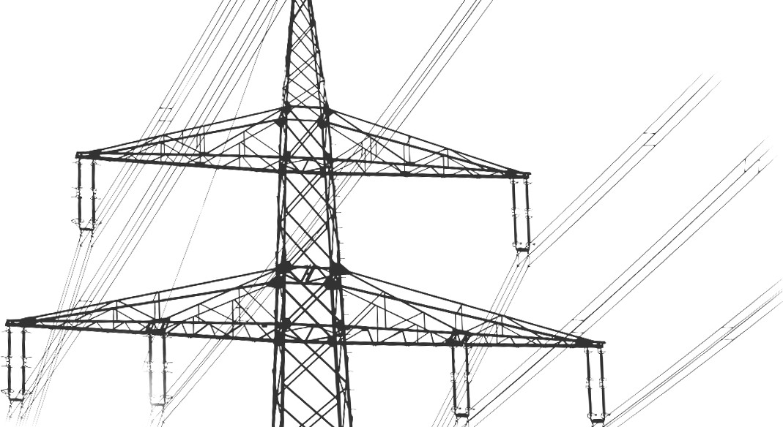
Generators
Overview
Install some power plants onto an island where everybody “lives on the edge” of a giant weighted cycle.
To do this, pick some edges and vertices such that each vertex is connected to a marked vertex via a direct or indirect path.
? correct • solved at: ??:?? by
??
??
Author: Timon Knigge

Slide 16
Generators - Solution
Techniques
Algorithm
Spanning Trees
Transform it into a “minimum spanning tree” problem where every node has to be connected to a virtual “power” node.
We’ll put this power node at the centre and connect it to everything else with a weight according to the cost of installing a power station there.
Prim’s or Kruskal’s algorithms can do the rest.

Slide 17

Haughty Cuisine
Overview
Solve an annoyance by picking a list of food items from a list of set menus at random.
?? correct • solved at: ??:?? by
??
??
Authors:
Pim Spelier, Mike de Vries, Ragnar Groot Koerkamp, Robin Lee

Slide 18
Haughty Cuisine - Solution
Techniques
Algorithm
Implementation
Read in the size of the first menu, and immediately print it back out again.

Slide 19

Incomplete Sort
Overview
Sort an array by sorting half of it three times.
?? correct • solved at: ??:?? by
??
??
Author: Jorke de Vlas

Slide 20
Incomplete Sort
Incomplete Sort - Solution
Techniques
Algorithm
Divide and conquer
Permutations
Idea:
  In the first step, sort the first quarter.
  In the second step, sort the second quarter.
  In the final step, sort the remaining numbers.
To accomplish this:
  First step: Choose the first n/4 numbers and the positions of the first n/4 numbers, so that the first n/4 numbers are forced into the first quarter.
  Second step: Choose the next n/4 numbers and positions, for the same reason.
  Third step: Just sort everything else (n/2)

Slide 21

Jigsaw
Overview
Determine whether a jigsaw puzzle is solvable from the numbers of each kind of piece.
?? correct • solved at: ??:?? by
??
??
Author: Mike de Vries

Slide 22
Jigsaw - Solution
Techniques
Algorithm
Ad Hoc
A jigsaw puzzle of size w · h contains:
  4 corner pieces
  2(h − 2) + 2(w − 2) edge pieces
  (h − 2)(w − 2) center pieces
This reduces the problem to a simple system of equations.

Slide 23

Kleptocrat
Overview
Given a connected undirected graph, find a path from A to N that minimizes XOR of the values on the edges.
? correct • solved at: ??:?? by
??
??
Author: Jorke de Vlas

Slide 24
Kleptocrat - Solution
Techniques
Algorithm
Linear Algebra
Cycles
Observation: walking back and forth does not change the XOR-value since x ⊕ x = 0.
When there is a cycle starting from c with XOR-value v , we may walk from a to c, around the cycle, back to a and then to b giving a value of w ⊕ v where w was the value of a path from a to b.
This is an equation over \mathbb{F}_2 and the v_i can be reduced with Gaussian Elimination giving 64 values.
Notes:
This solution is wrong.

Slide 25
Kleptocrat - Solution (cont.)
Techniques
Algorithm
Linear Algebra
Cycles
See v_i as vectors in F_2^64 by writing v_i in base 2.
The linear combinations form a subspace of dimension at most 64: find a basis, which has at most 64 elements.
Now, given an initial path w, for i from 63 to 0, look if w has a 1 in the ith binary digit and check if there is a basis element with i as most significant digit, in which XOR w with this value.
Notes:
This solution is wrong.

Slide 26

Lost Map
Overview
Two map fragments (strings) are badly damaged and some items are replaced by “?”s
Find how many ways you can overlay the two fragments so that no non-”?” values conflict.
?? correct • solved at: ??:?? by
??
??
Author: Robin Lee

Slide 27
Lost Map - Solution
Techniques
Algorithm
FFT
Convolution
We can treat the “?” and non-”?” values completely separately.
  We make two separate binary strings
    One encoding “?” as 0 values and everything else as 1 values
    One encoding “?” as several -1s and everything else as its binary representation (takes LogK bits where K is the number of directions)
  If we reverse one array, then the convolution of both versions of the binary strings from each map can be used to find the number of bits matching each time
    We need the number of bits across both convolutions to exactly equal the length of the string.
Pitfalls: FFT needs to be fast.

Slide 28
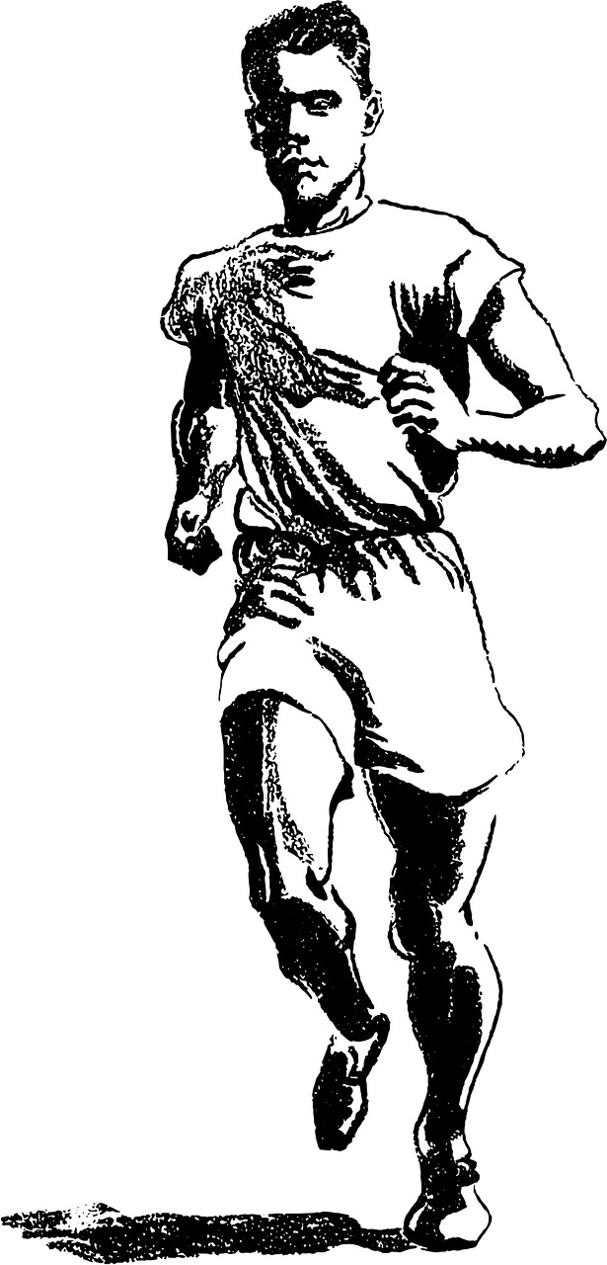
Moderate Pace
Overview
Print the median value at the same index of three different arrays.
?? correct • solved at: ??:?? by
??
??
Author: Bergur Snorrason

Slide 29
Moderate Pace - Solution
Techniques
Algorithm
Sorting
Implementation
Read in the three arrays and iterate from i=0 to i=n-1
  Create a new list L with the three items at index i and sort it
  Print L[1], and move onto the next.

Slide 30

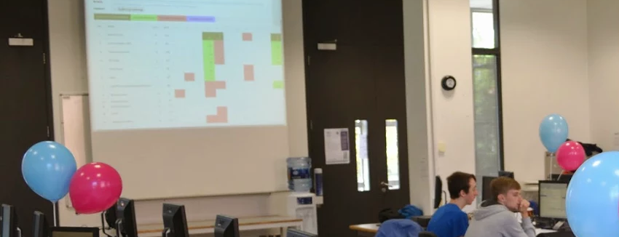

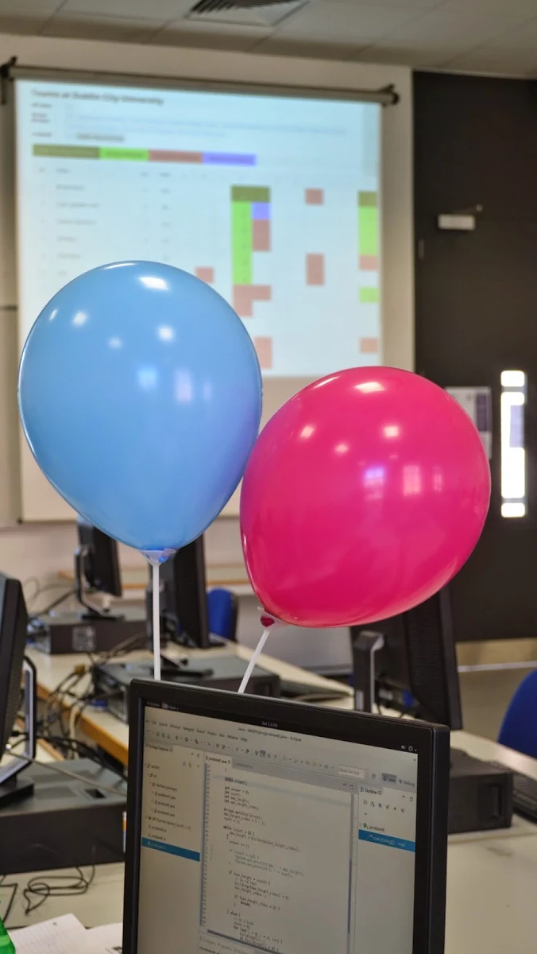
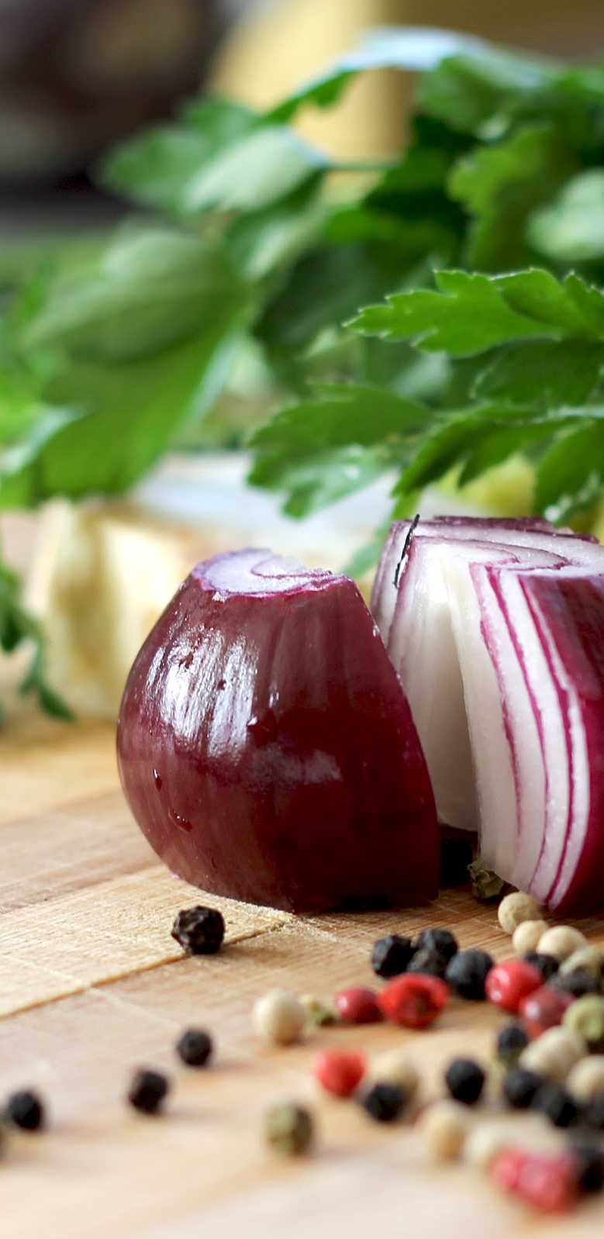
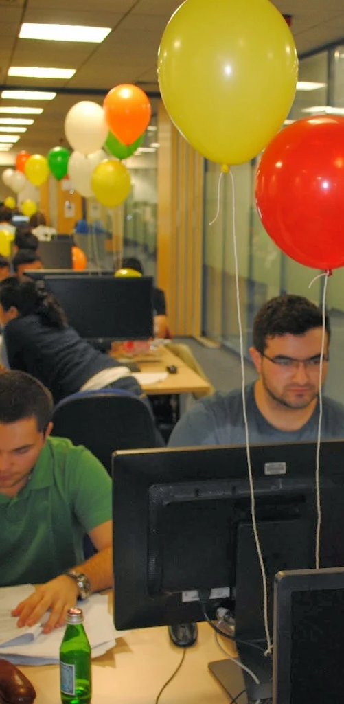
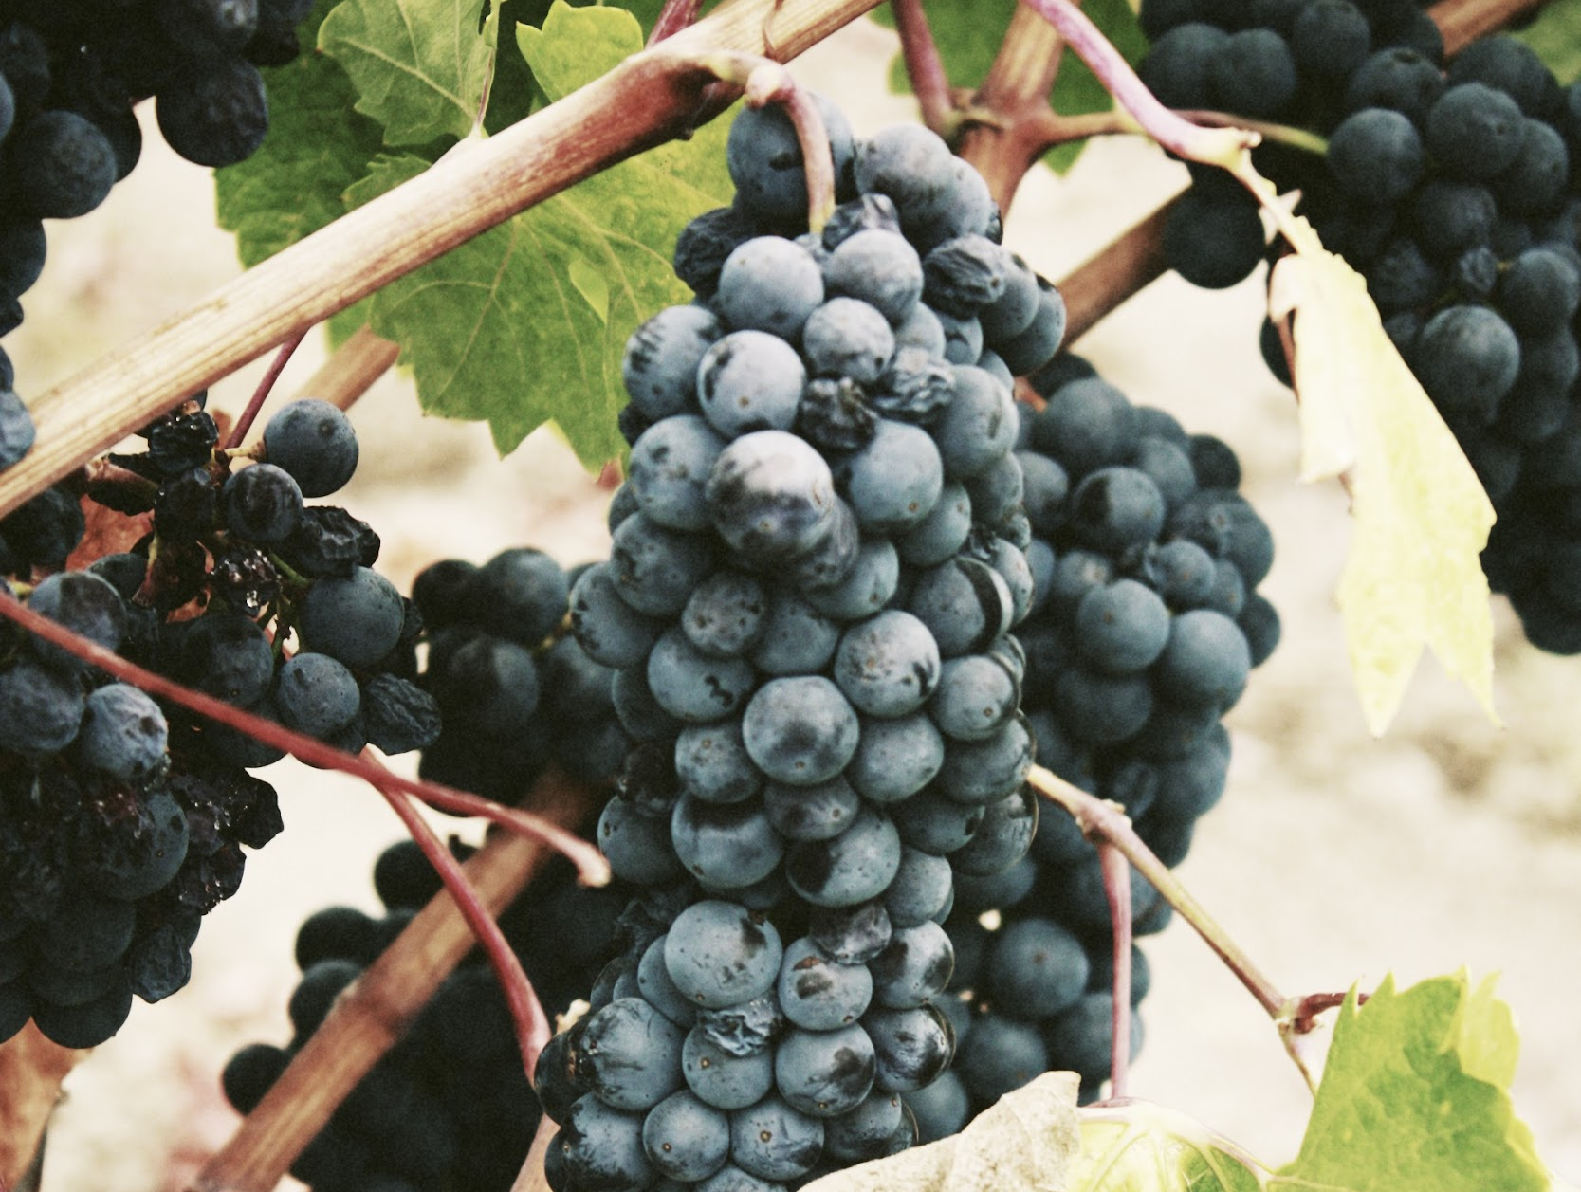
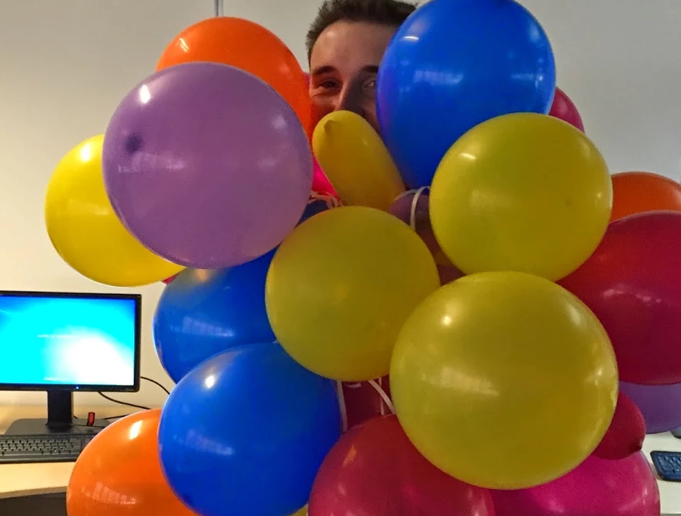

Slide 31
Questions?
Or comments?

Slide 32

Final Standings
http://domjudge.bath.ac.uk/

